Slide 1
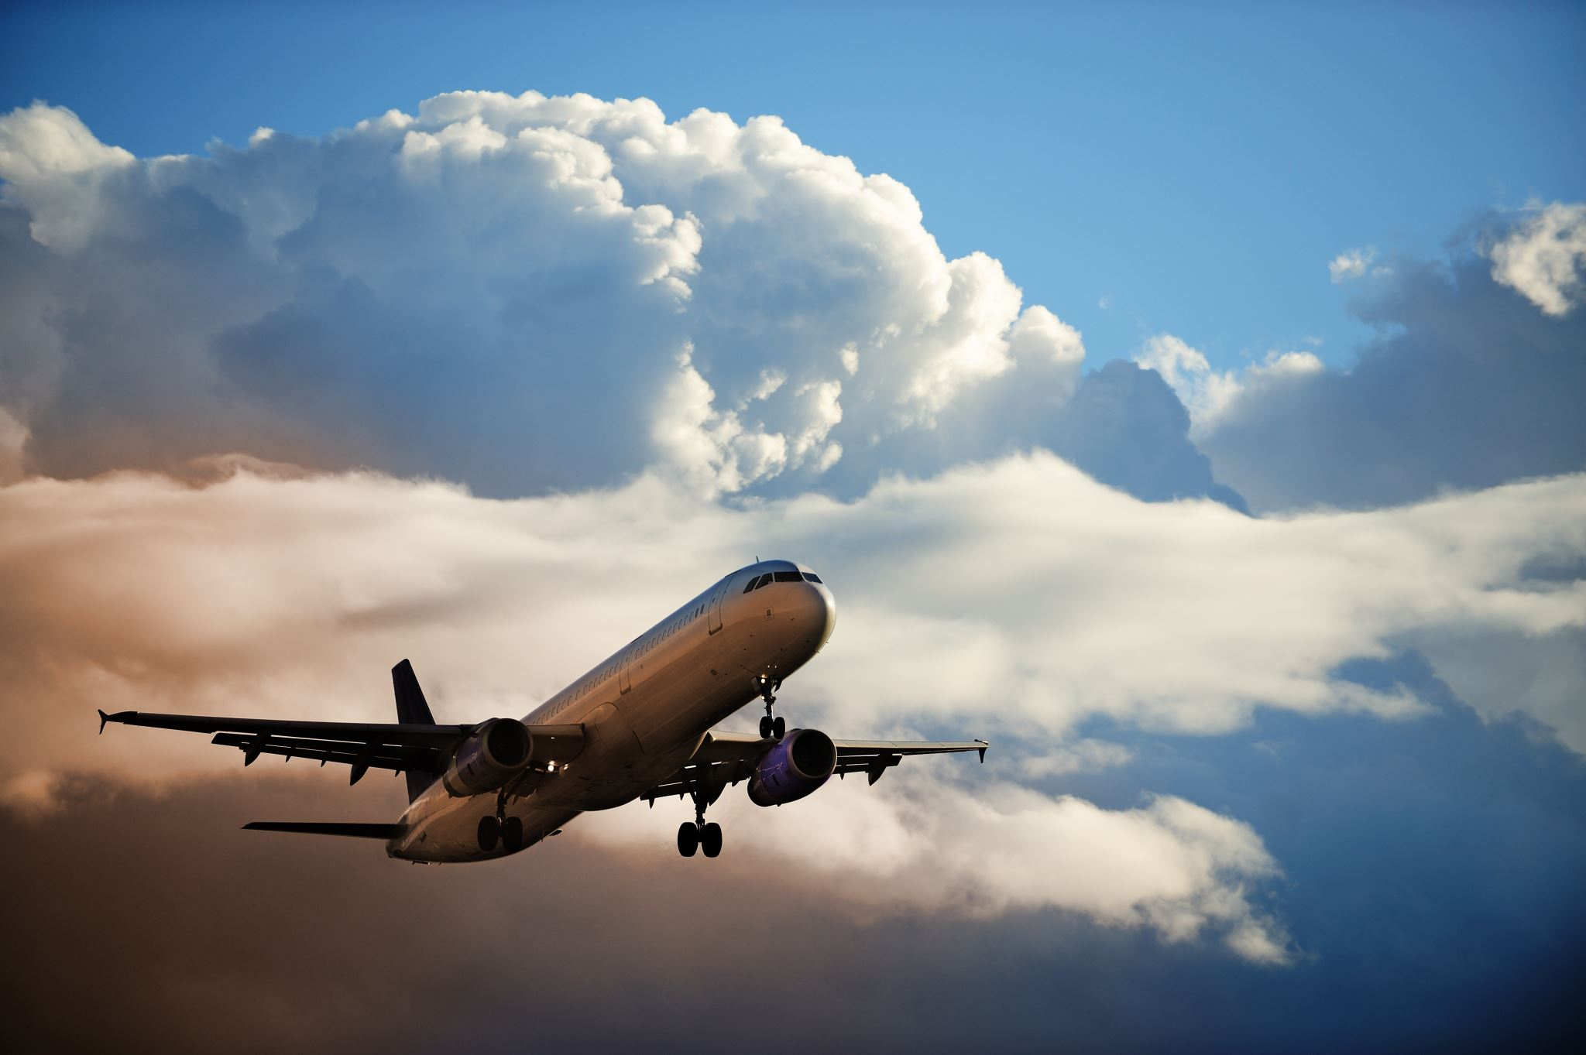
U.S. Flight Delay & Cancellation Analysis
Divya Vegi
Capstone Presentation
Nashville Software School

Slide 2
Data Overview & Business Questions
Dataset: U.S. domestic flight data from the Bureau of Transportation Statistics (DOT), Hourly Weather Data 2024
Preparation & Cleaning:
Combined monthly files into a single year dataset for year-level analysis
Processed millions of flight records across airlines and airports
Standardized time fields and aligned delay measurements
Optimized the dataset for large-scale analysis and visualization
Flight is considered delayed if delay is >15
Business Questions:
When are flights most likely to be delayed or cancelled?
How do delays vary across airlines
Are delays driven more by airline operations or external factors?
Notes:
H

Slide 3
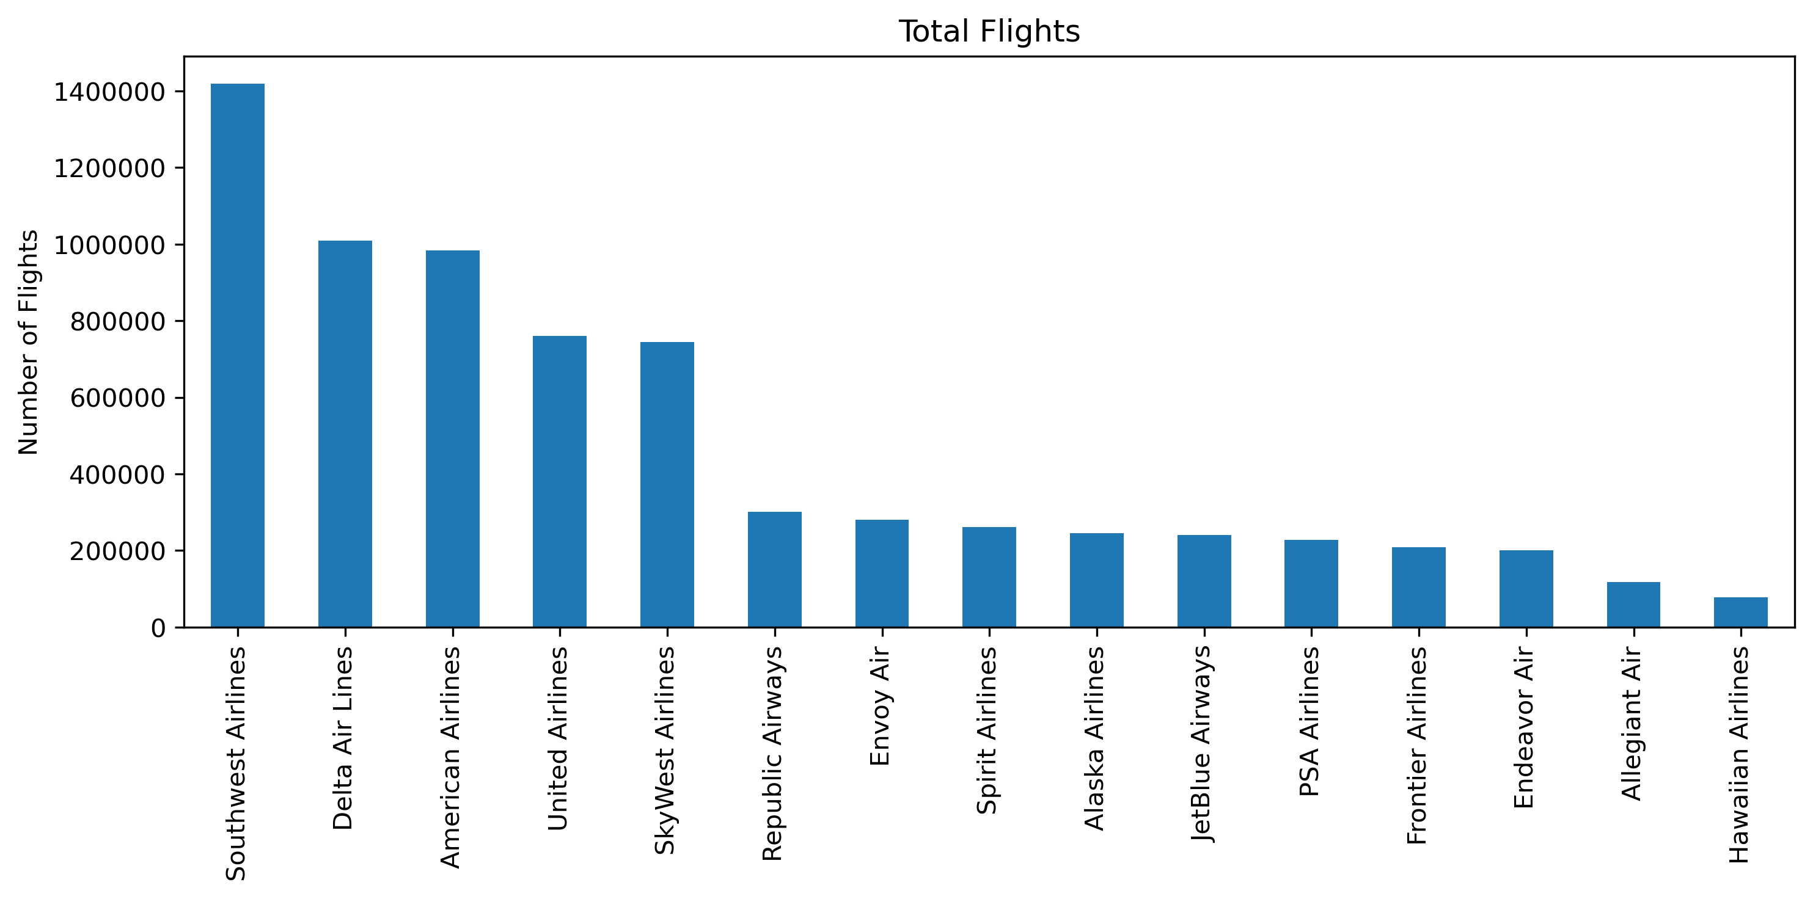
Total Flights by Airline
A small number of major airlines operate most U.S. domestic flights.
Southwest, Delta, American, and United dominate total flight volume.
Regional carriers support major airlines and are more exposed to upstream disruptions.
Higher volume amplifies delay and cancellation impacts across the network.

Slide 4
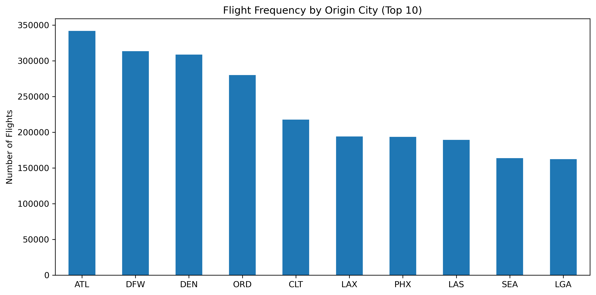
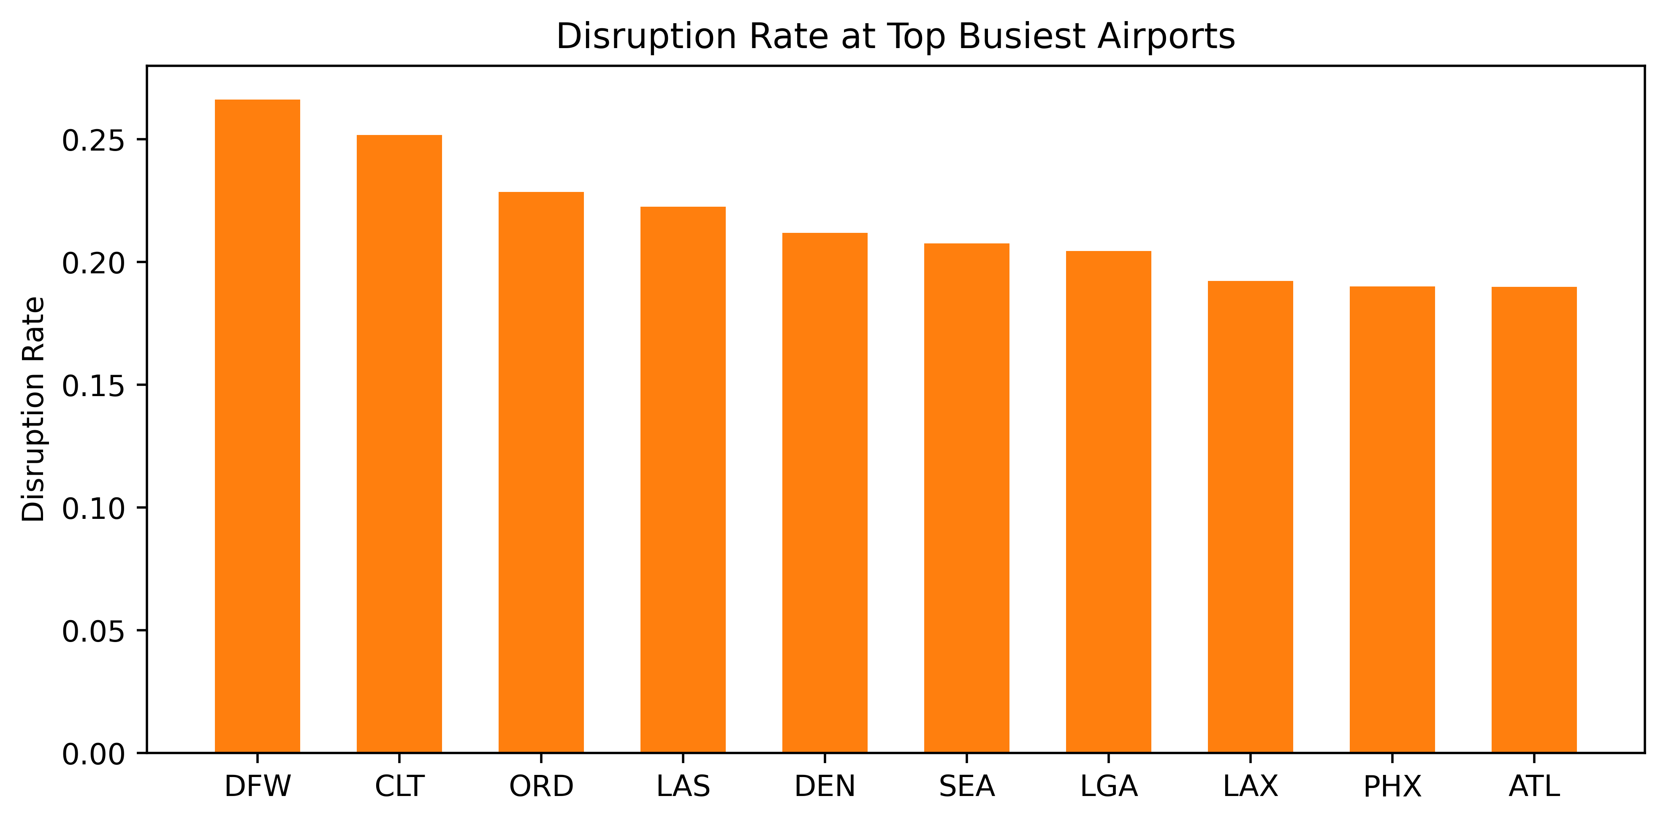
Airports – Flight Volume & Disruptions
ATL is the busiest U.S. airport by total flight volume.
DFW, DEN, and ORD also serve as major connection hubs with heavy traffic.
High-volume hubs act as network bottlenecks, increasing disruption risk.
Disruption rates vary widely, showing that volume alone does not determine performance.

Slide 5
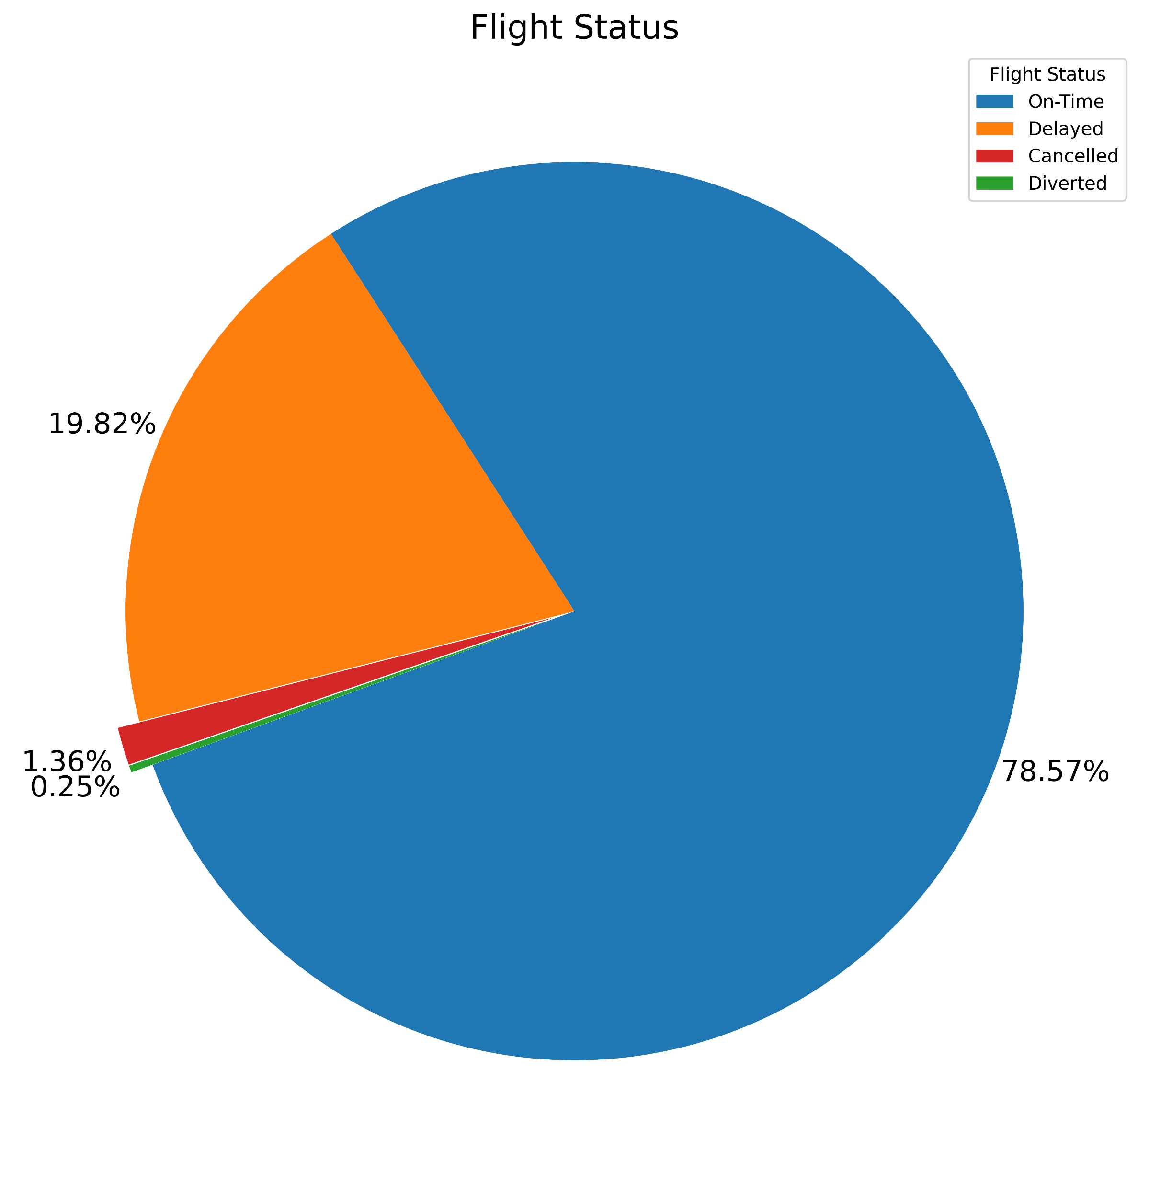
Flight Status
Most flights operate successfully — nearly 79% arrive on time.
Delays are the primary disruption, affecting about 1 in 5 flights.
Cancellations and Diversions are rare and typically occur during major disruption events.

Slide 6
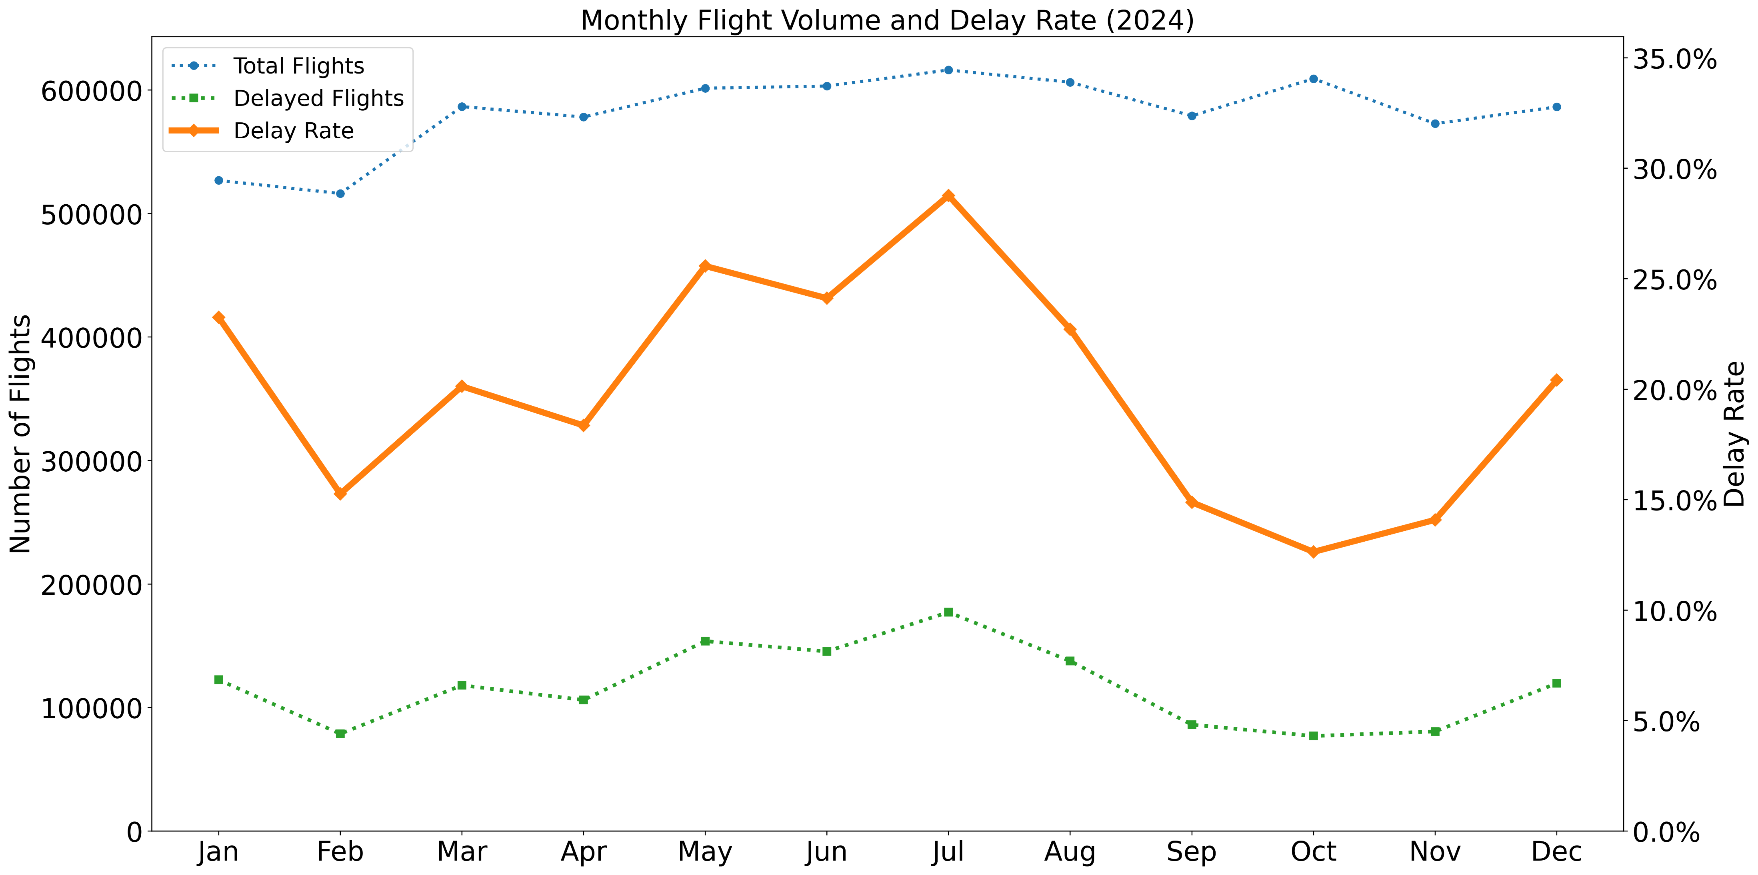
Delays across months
Delay rates fluctuate throughout the year
Delay Peaks align with busy travel and adverse weather periods
Lower rates seen in off-peak seasons
Highlights seasonal operational stress.
Notes:
N

Slide 7
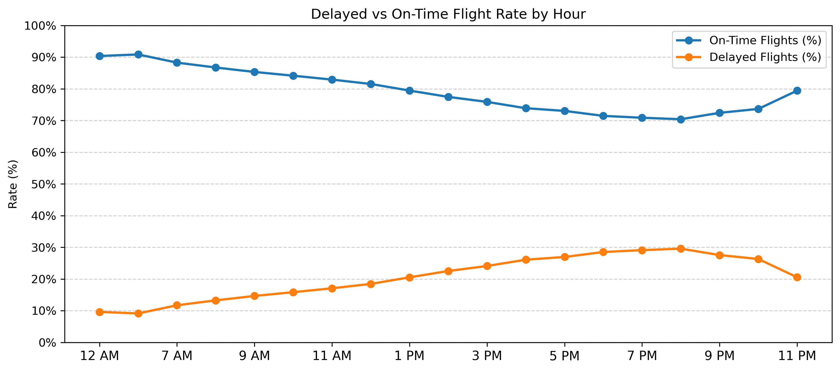
Delay Rate By Time Of Day
Delay rates increase steadily from morning to evening.
Early flights experience fewer disruptions.
Evening delays reflect accumulated network congestion.

Slide 8
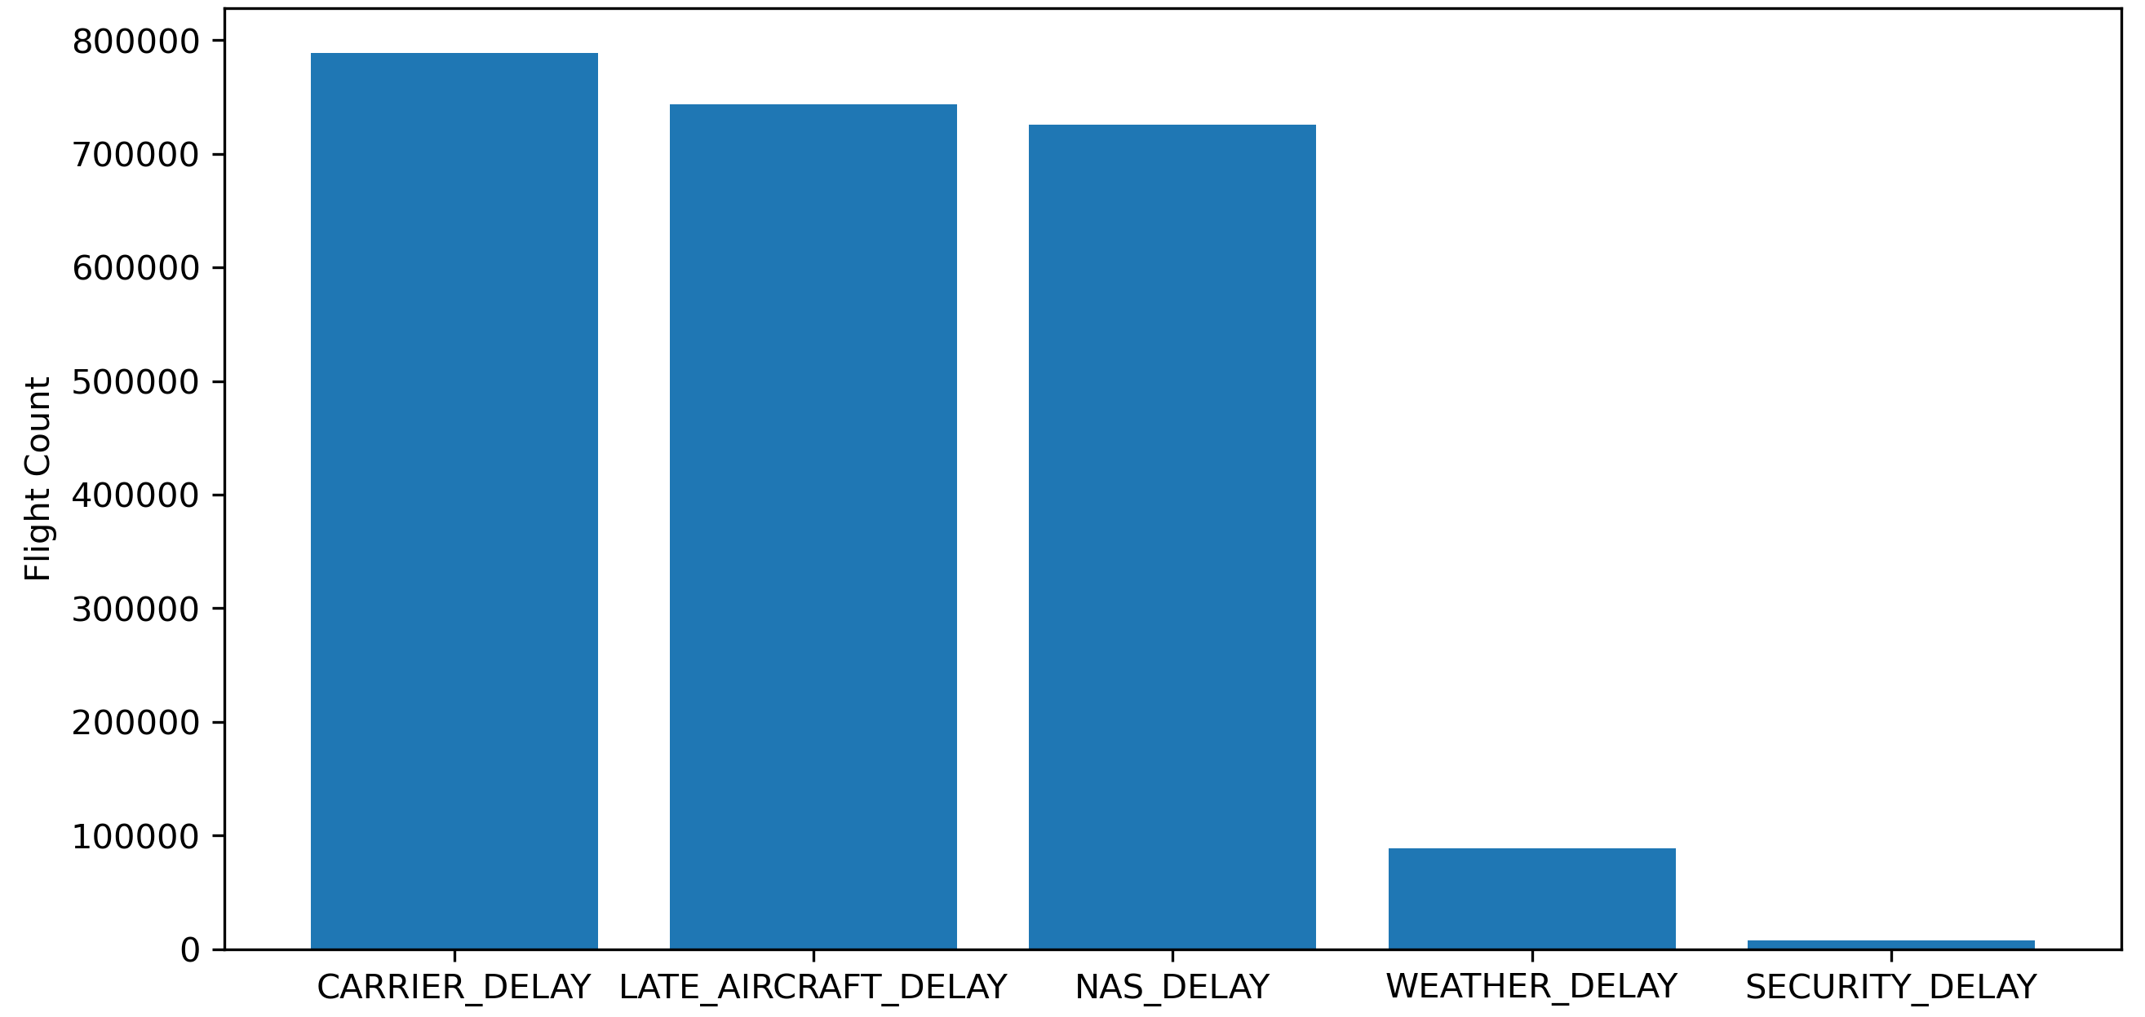
Delay Cause Ranking
Top 2 : Carrier & Late aircraft delays- the leading causes of flight disruptions are under airline control.
NAS delays reflect congestion at busy airports.
External factors like weather and Security delays are minimal compared to other causes

Slide 9
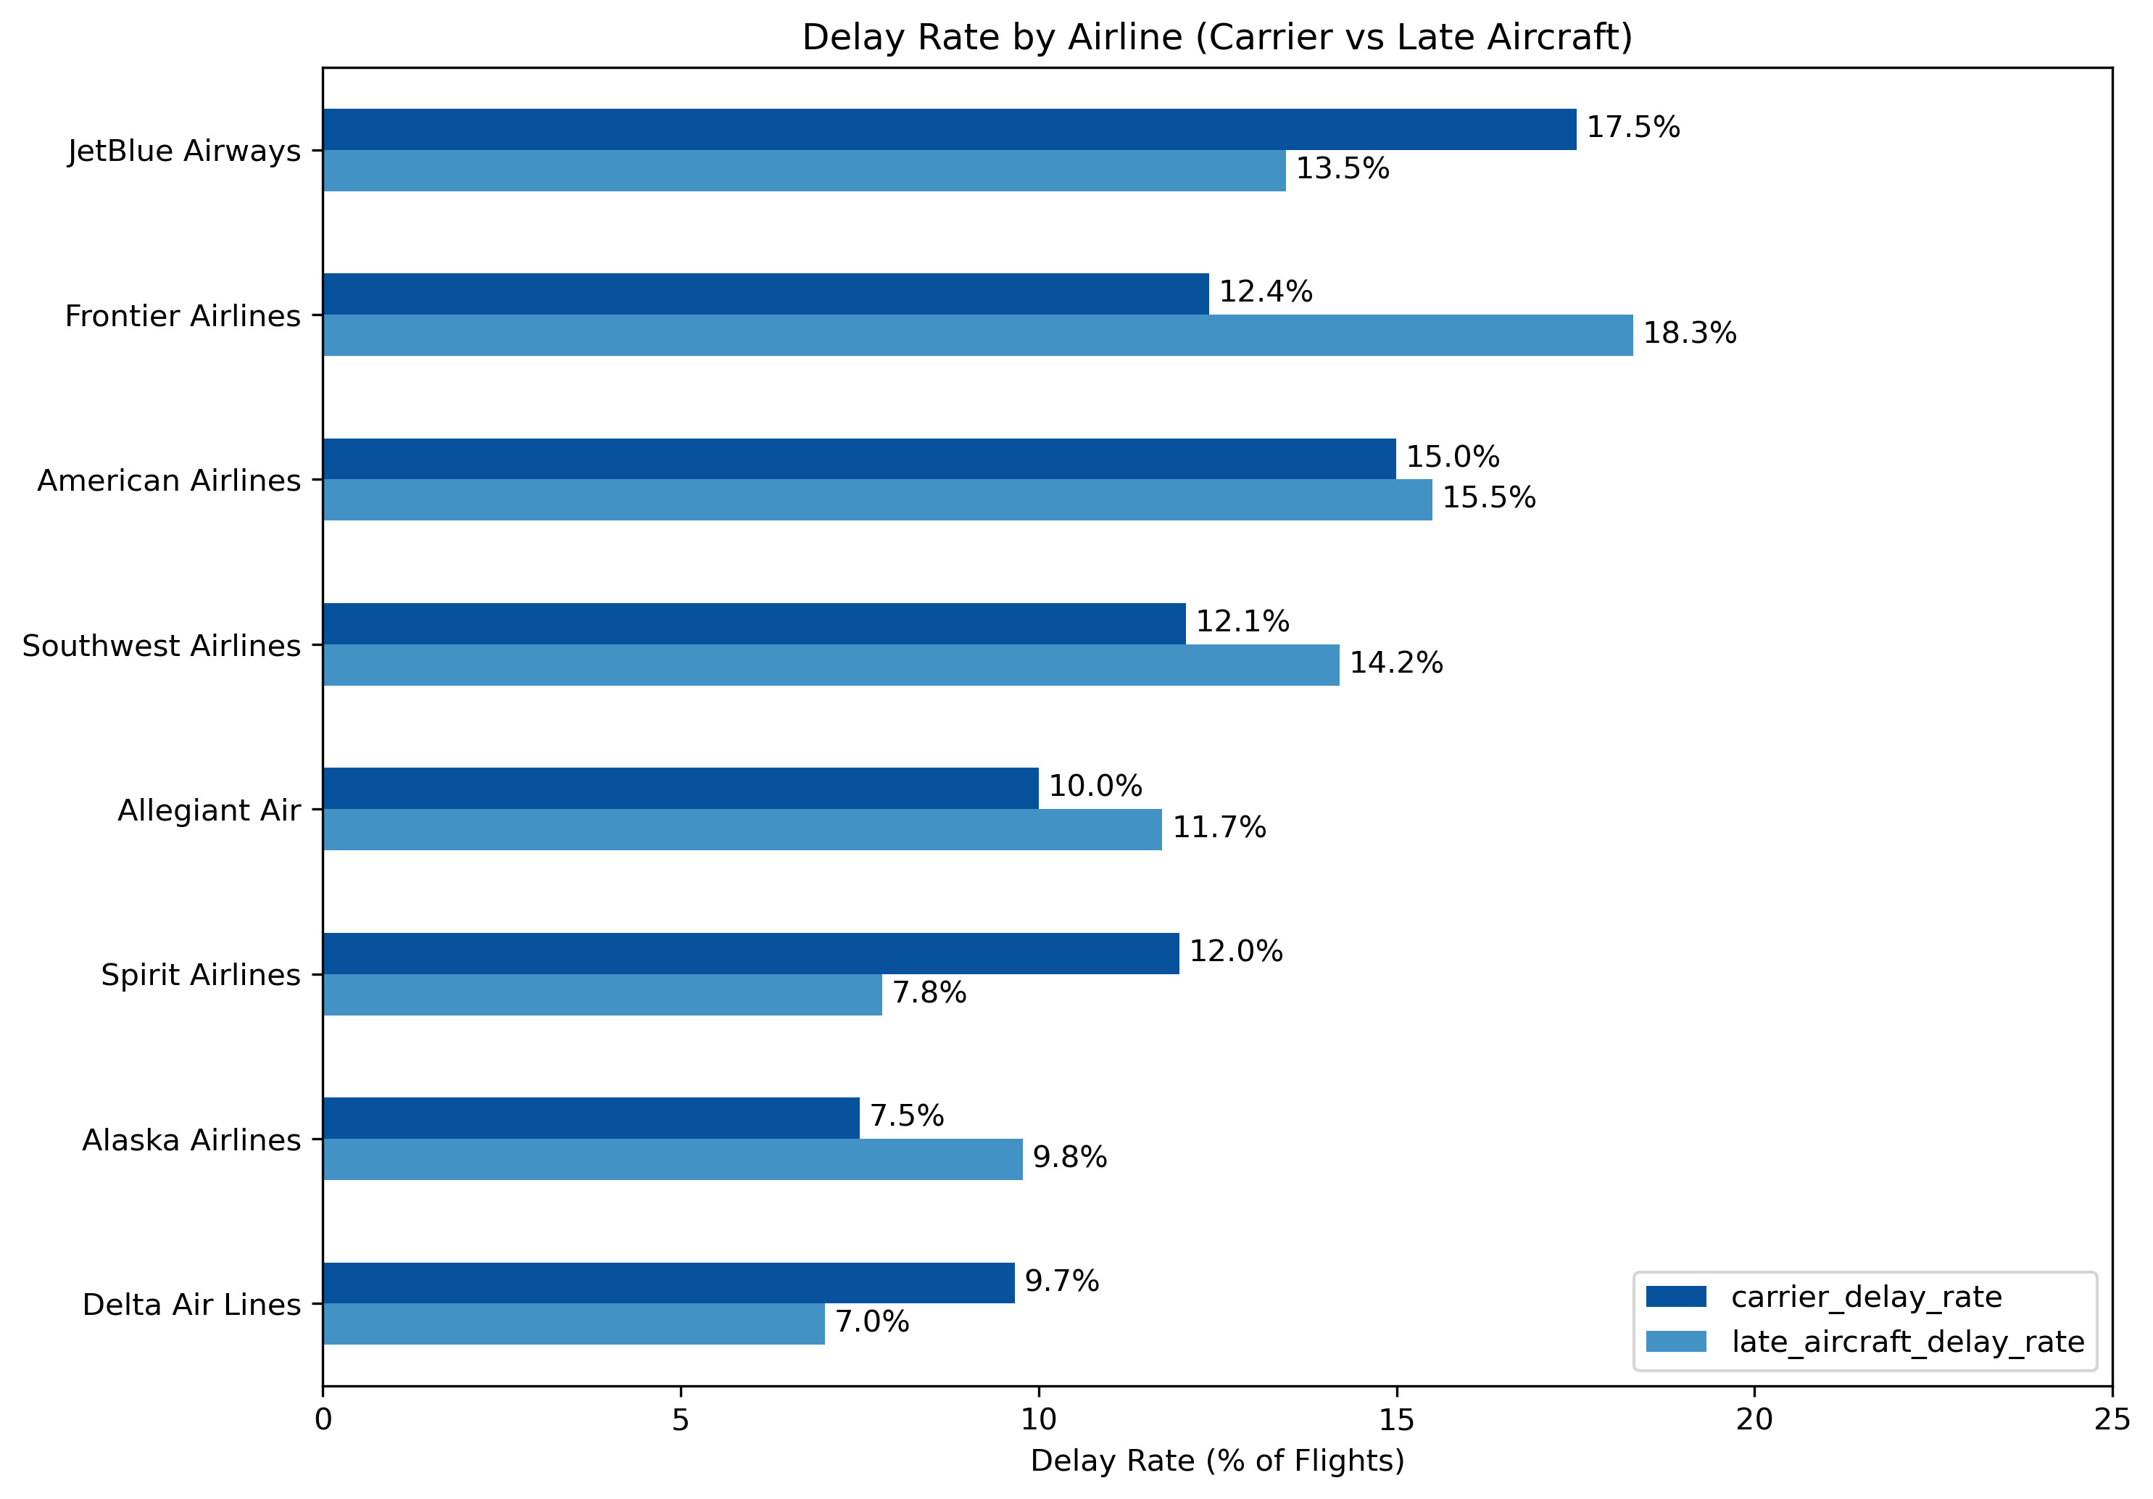
Delay Types across airlines
Carrier-delays are consistently significant, especially for large network airlines.
JetBlue and American show higher carrier delay rates.
Frontier is driven mainly by late-aircraft delays.
Delta and Alaska show lower delay rates, indicating strong reliability

Slide 10
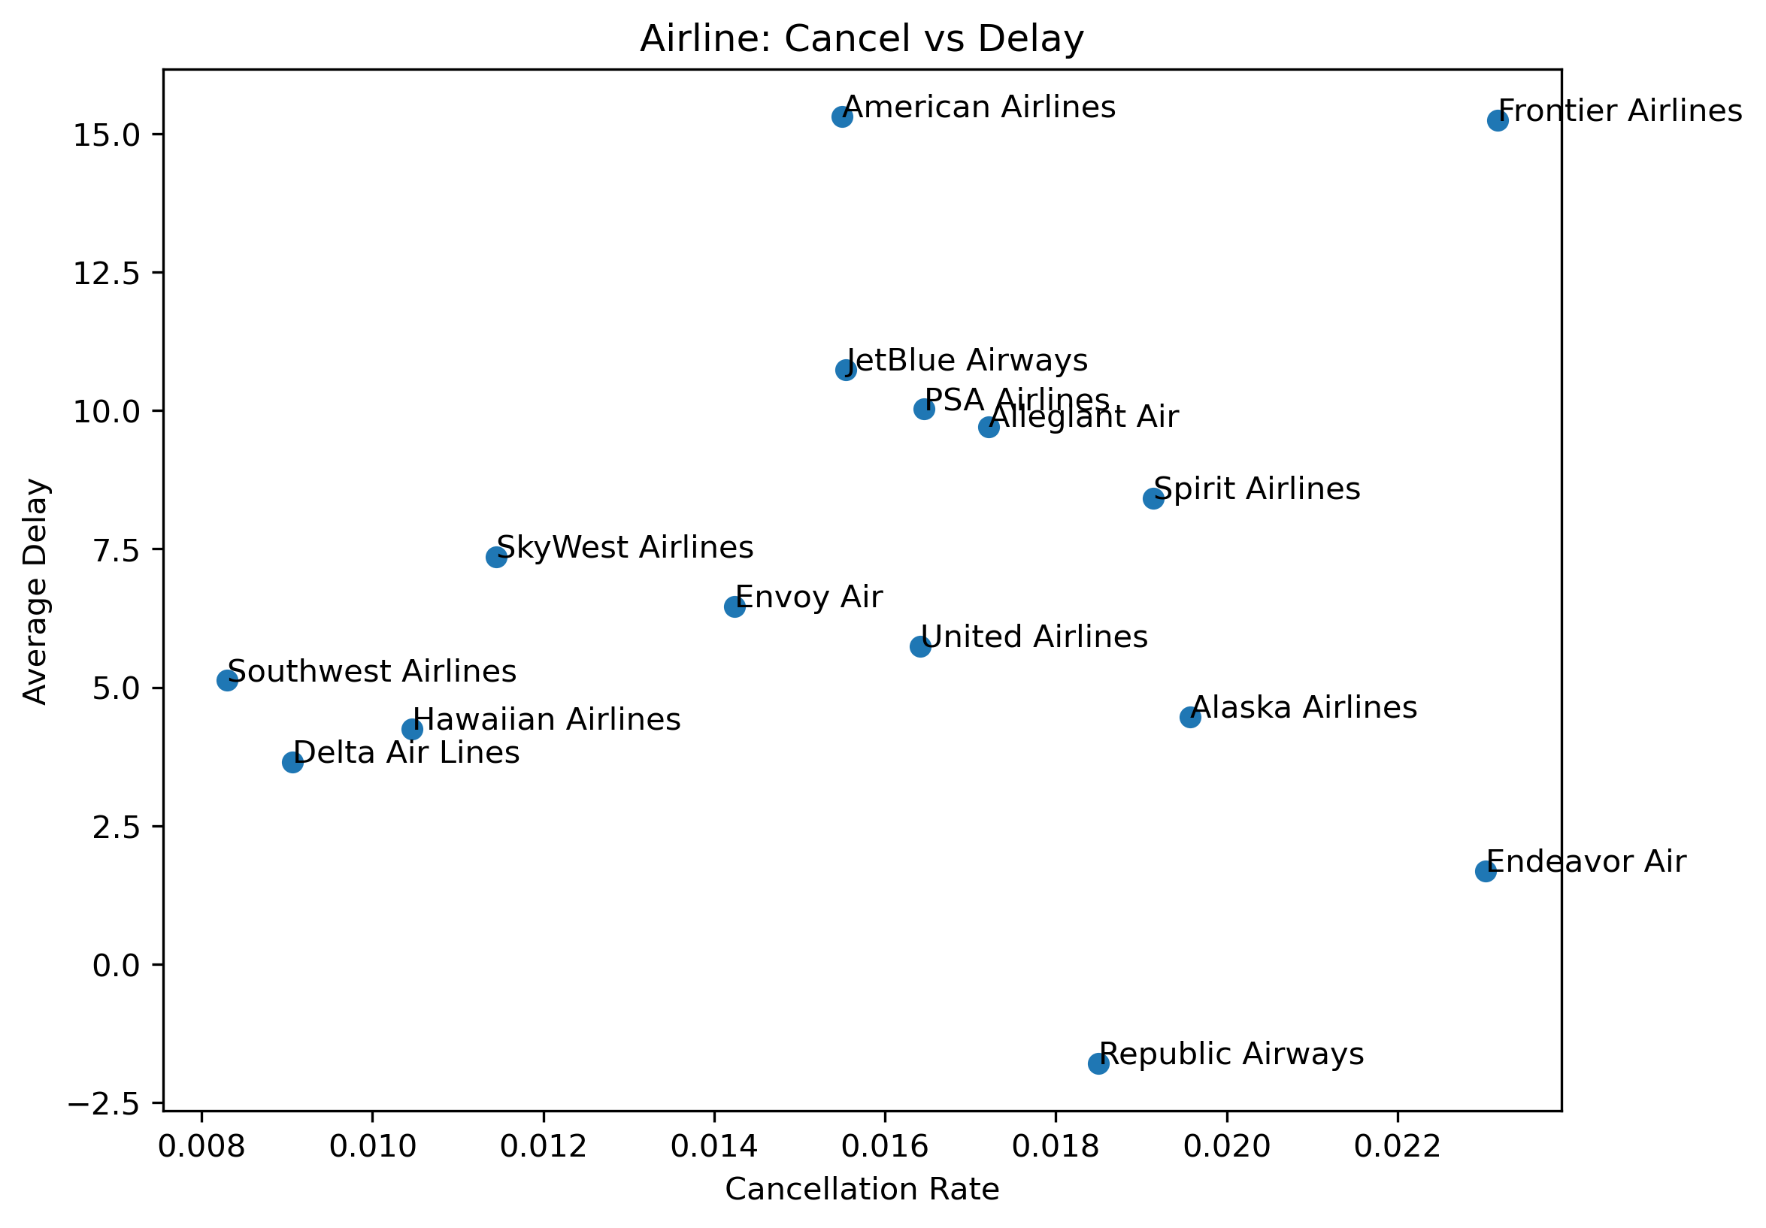
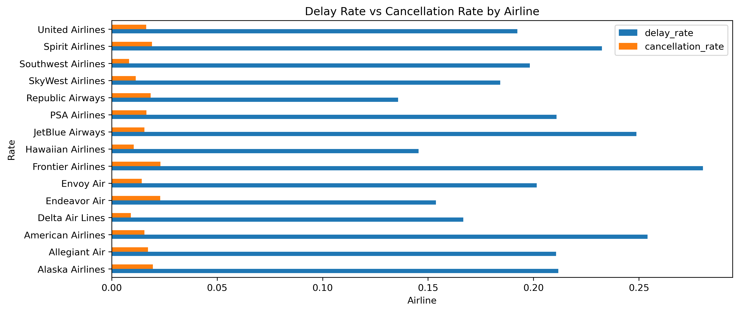
Cancellation & Delay Relationship
Airlines manage disruptions through delays or cancellations.
Frontier shows high delays and cancellations, indicating reliability challenges.
American and JetBlue favor delays over cancellations.
Delta and Southwest maintain lower disruption overall, reflecting stronger operational resilience.

Slide 11
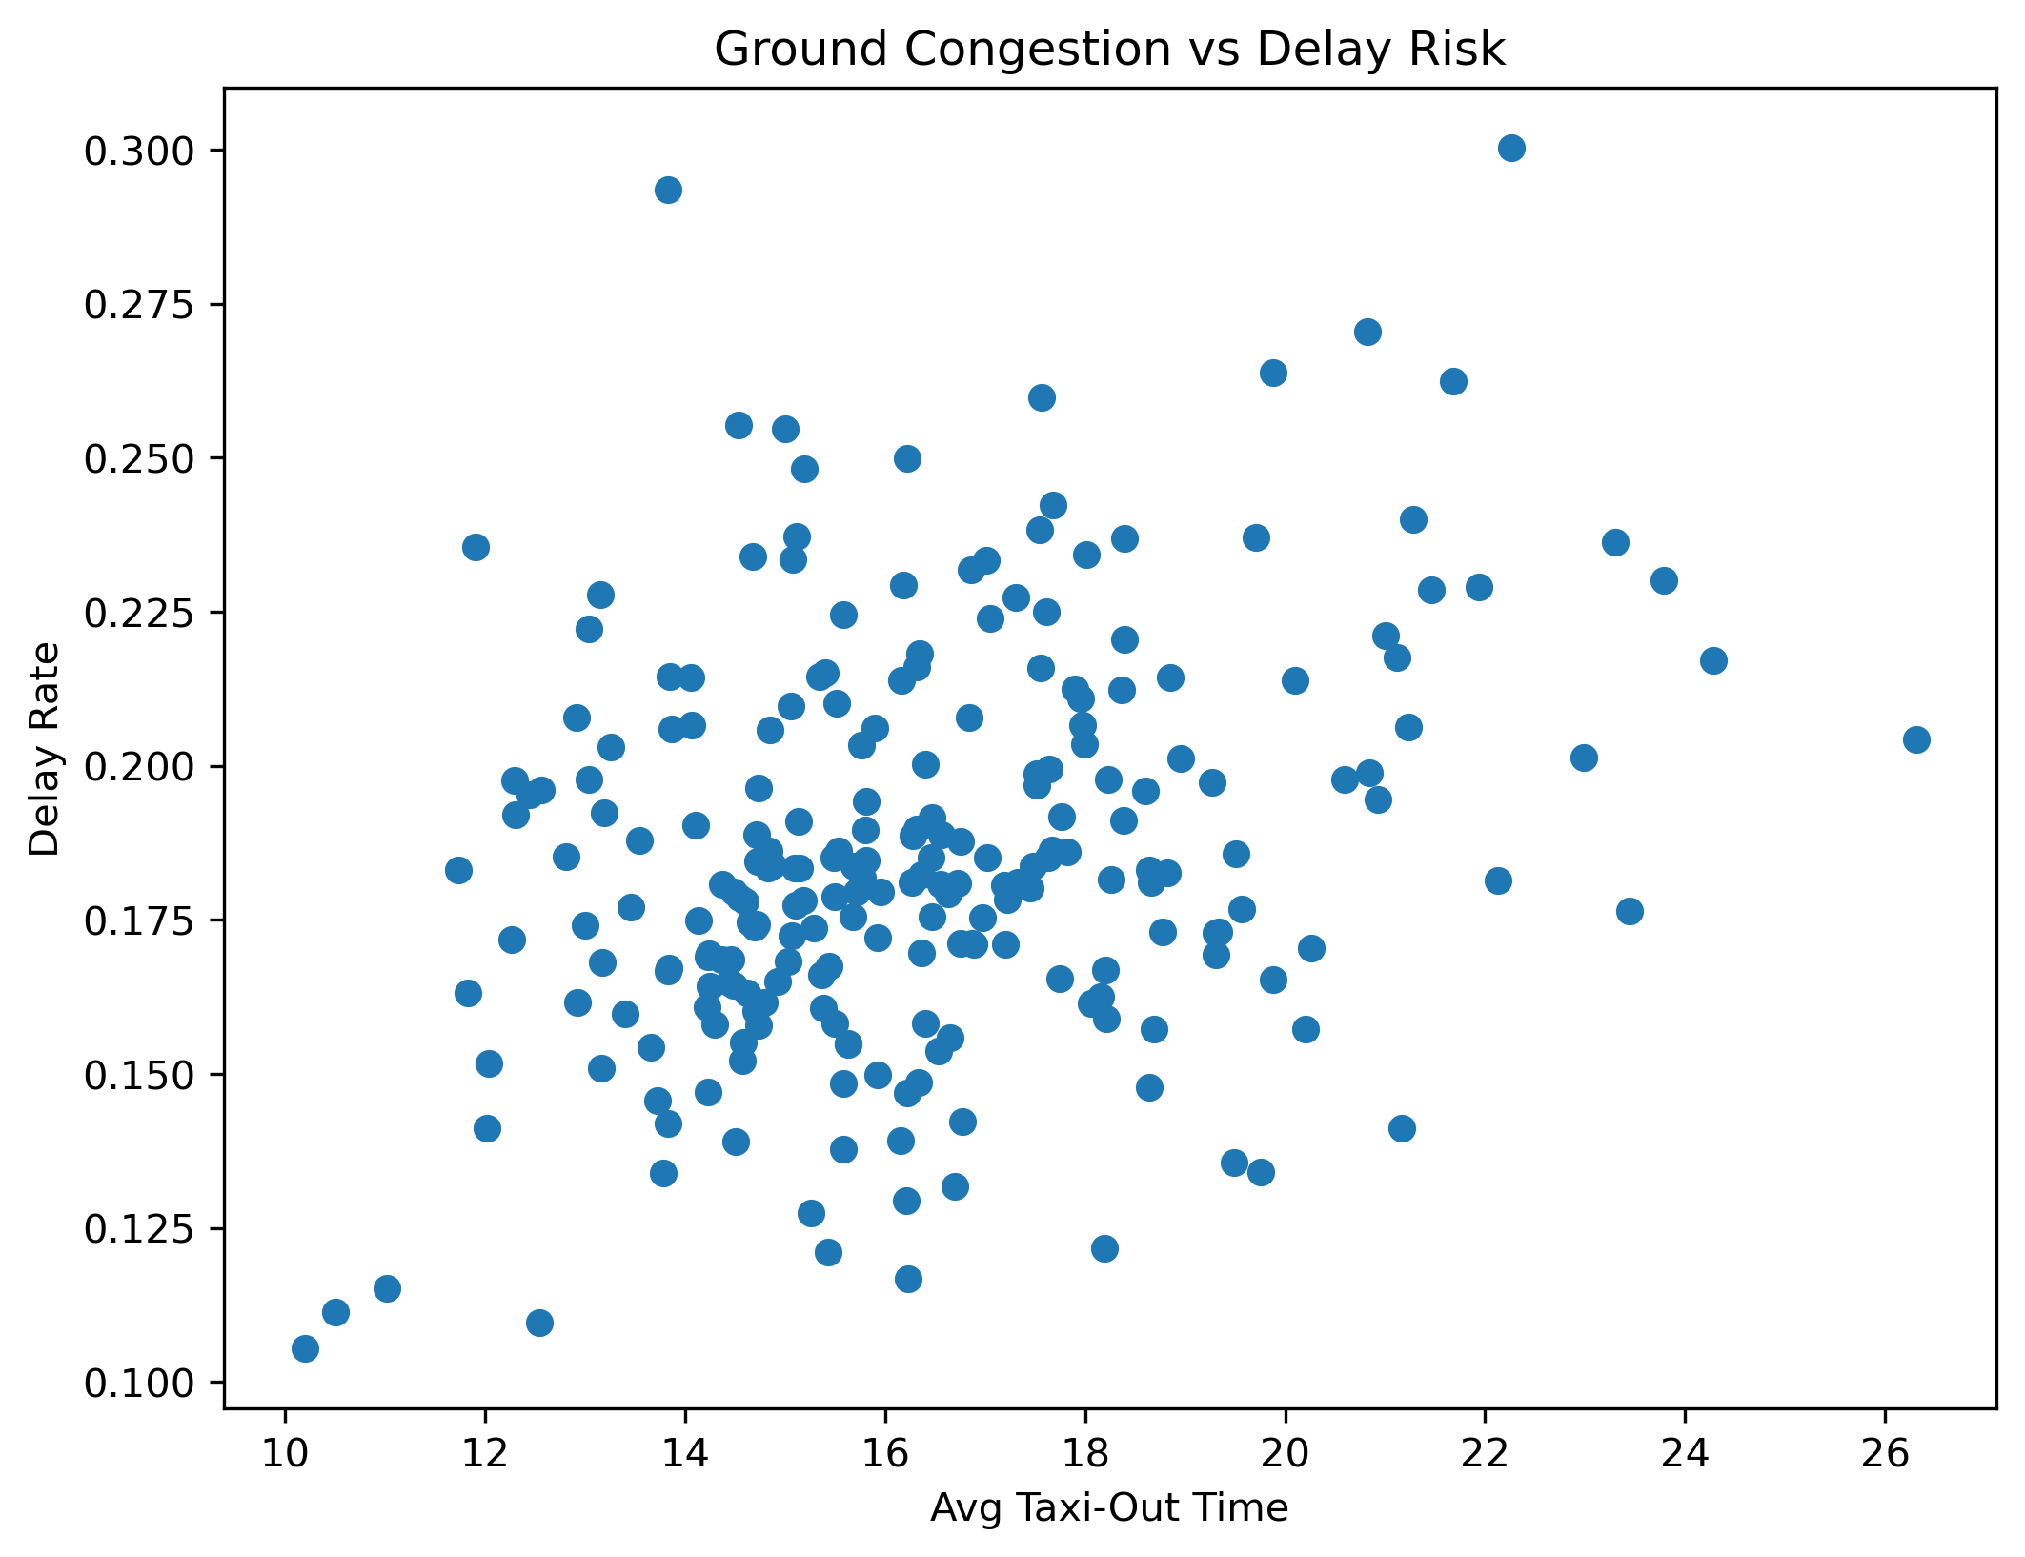
Airport Level Delays
Longer taxi-out times are linked with higher delay rates.
Ground congestion drives departure delays.
Indicates airport-level operational bottlenecks.

Slide 12
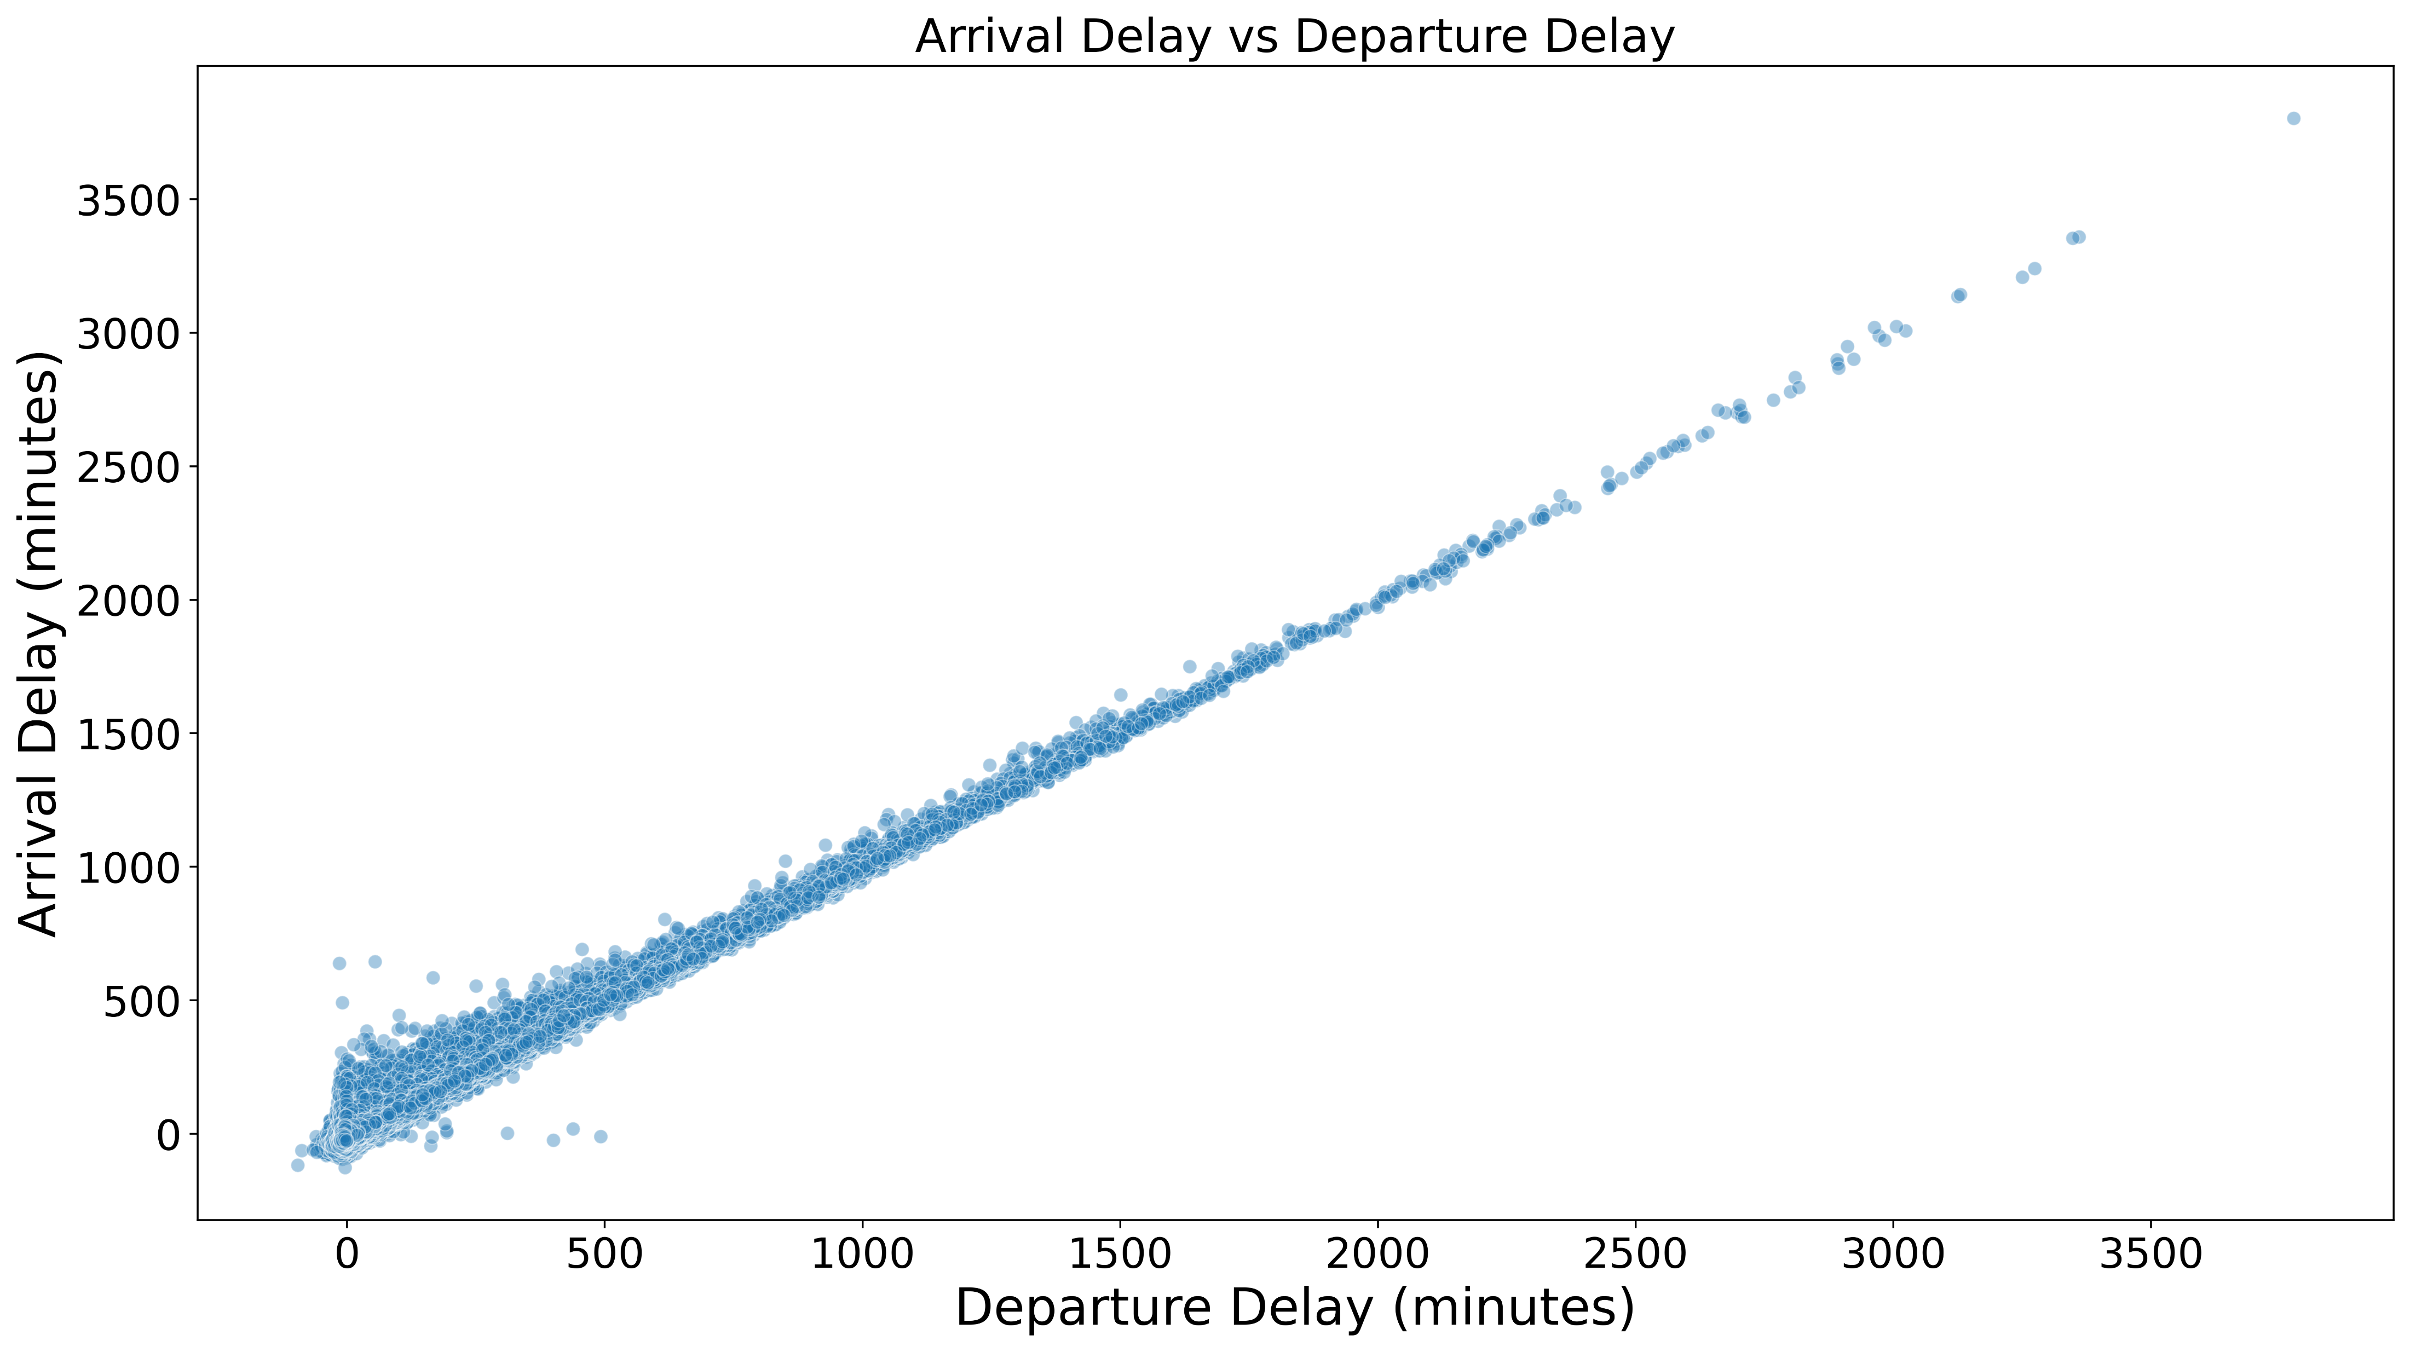
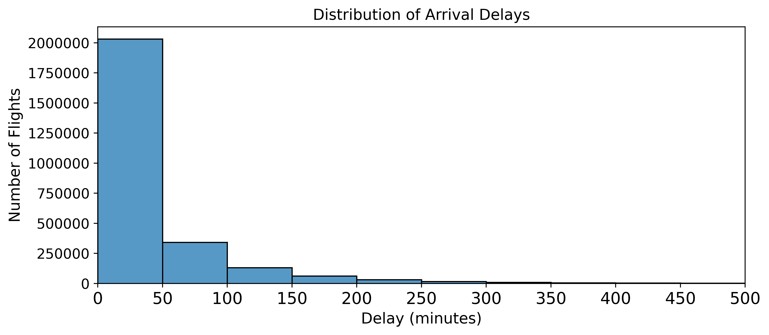
Delays Propagation & Severity
Departure delays strongly carry through to arrival, with limited recovery once a flight leaves late.
Most delays are short, but they occur at very high volume, affecting many passengers.
A small number of flights experience extreme delays (200+ minutes), creating outsized disruption.
Average delay metrics hide these extremes, making delay distribution more informative than the mean.

Slide 13
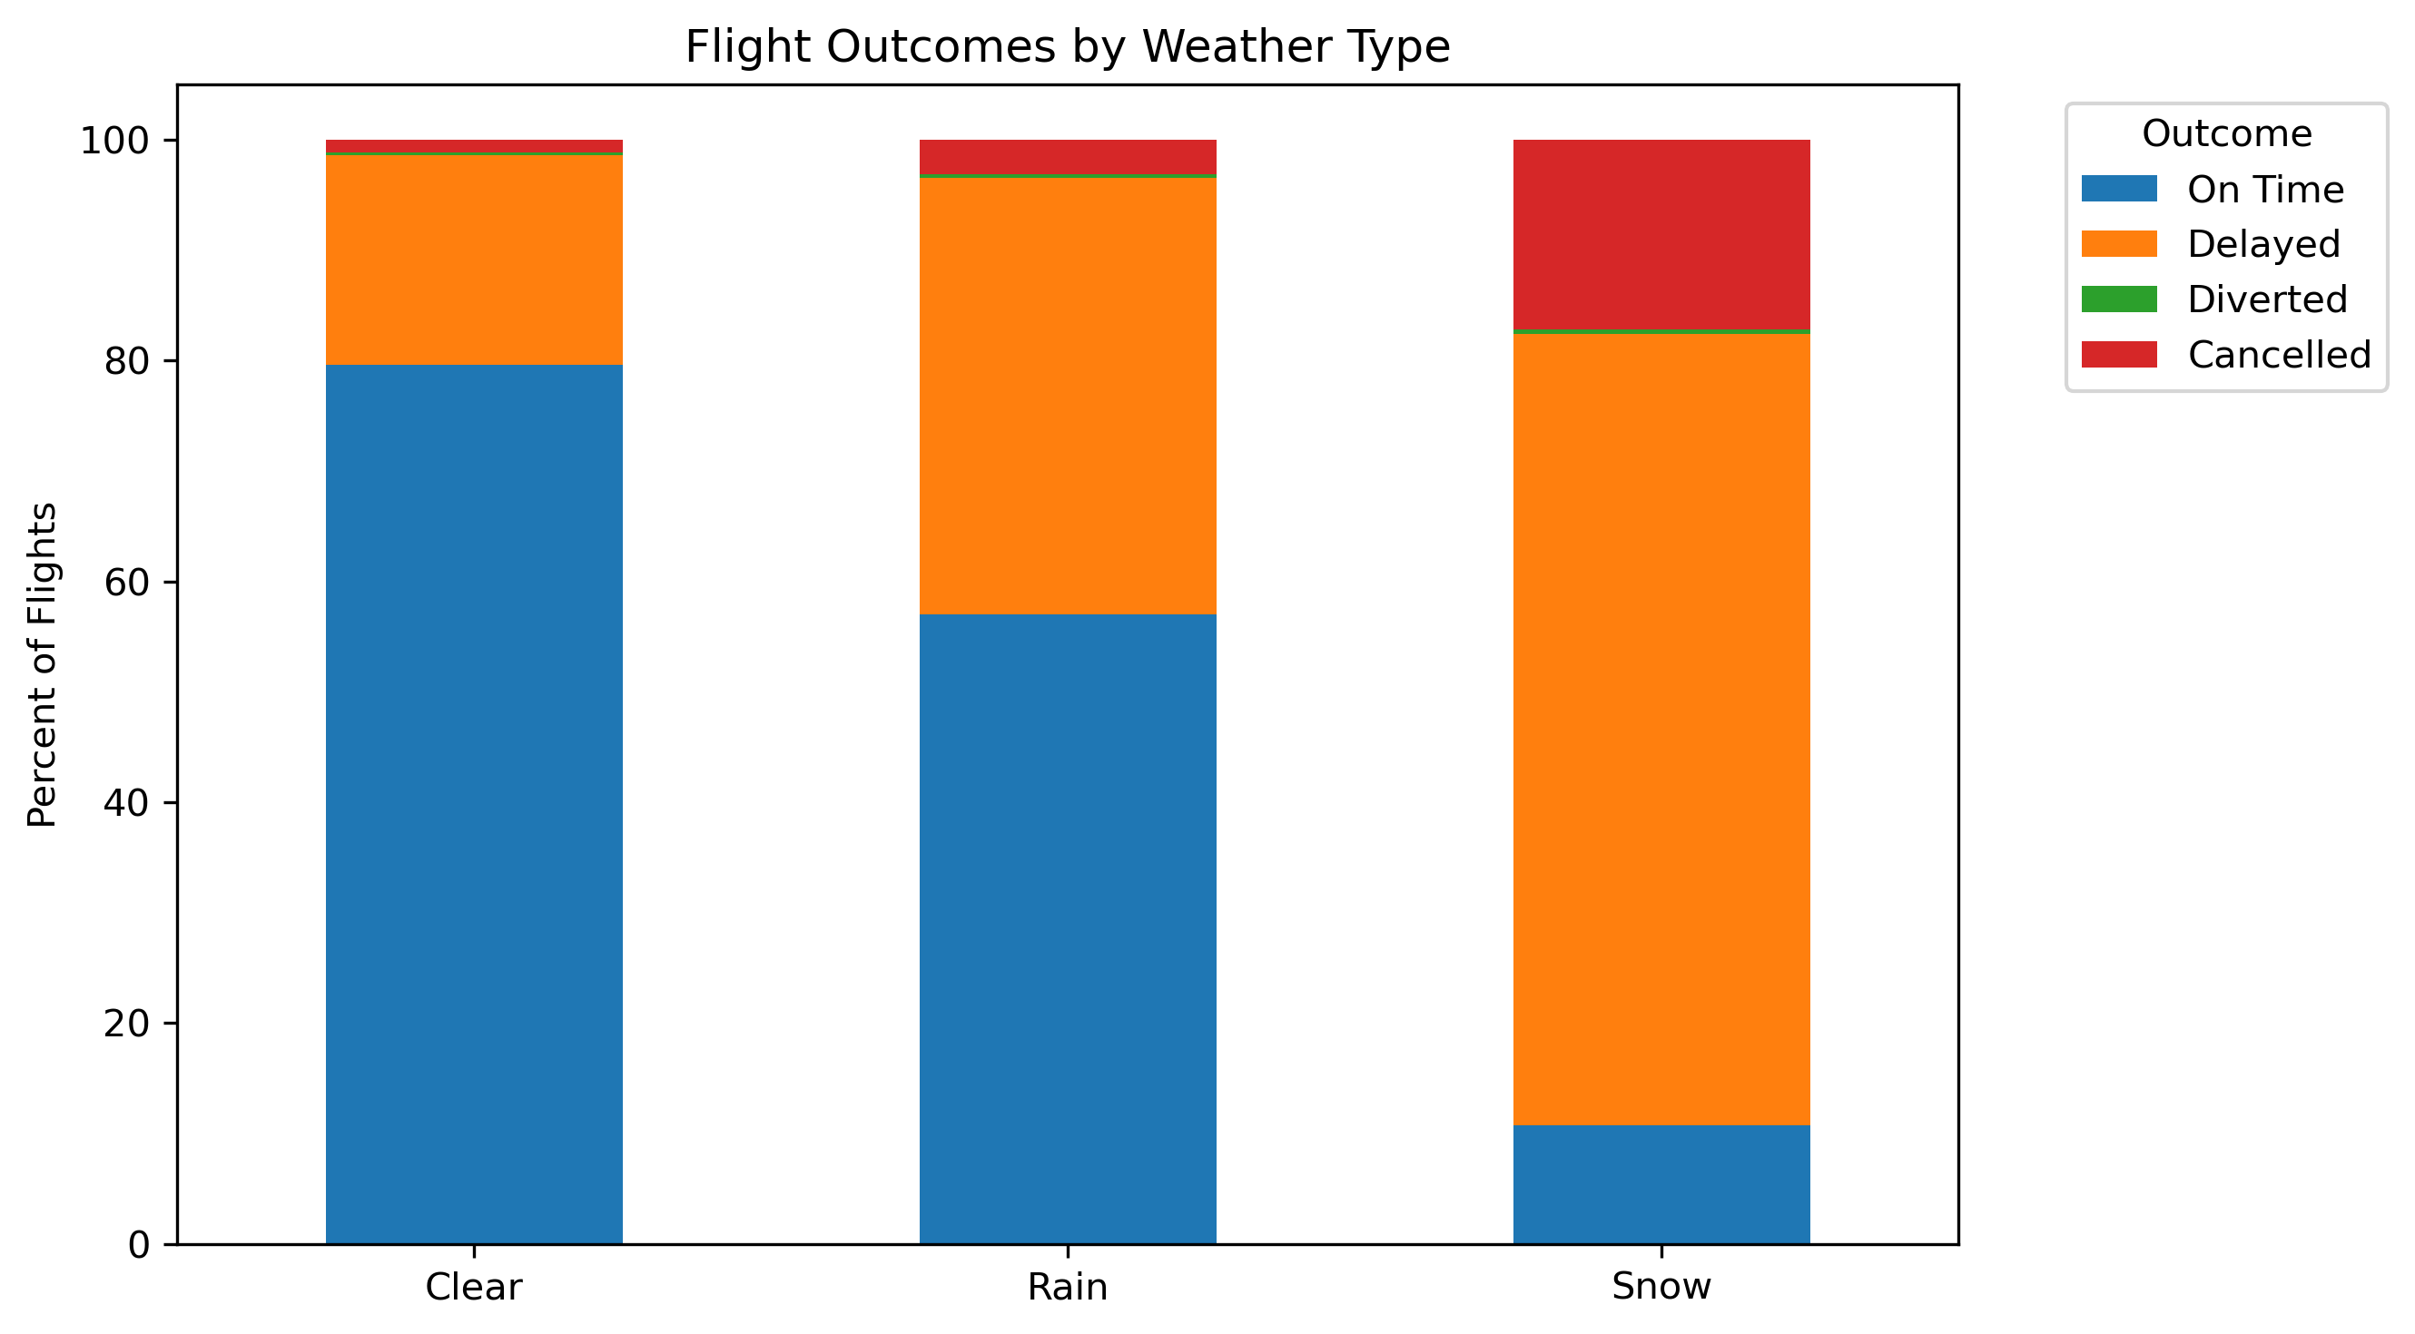
Flights – weather impact at major airports
weather | On Time | Delayed | Cancelled | Diverted
Clear | 79.61 | 18.96 | 1.19 | 0.24
Rain | 56.99 | 39.53 | 3.16 | 0.32
Snow | 10.77 | 71.67 | 17.15 | 0.41
Weather impacts were analyzed across major U.S. hub airports.
Snow and severe conditions drive the highest disruption levels.

Slide 14
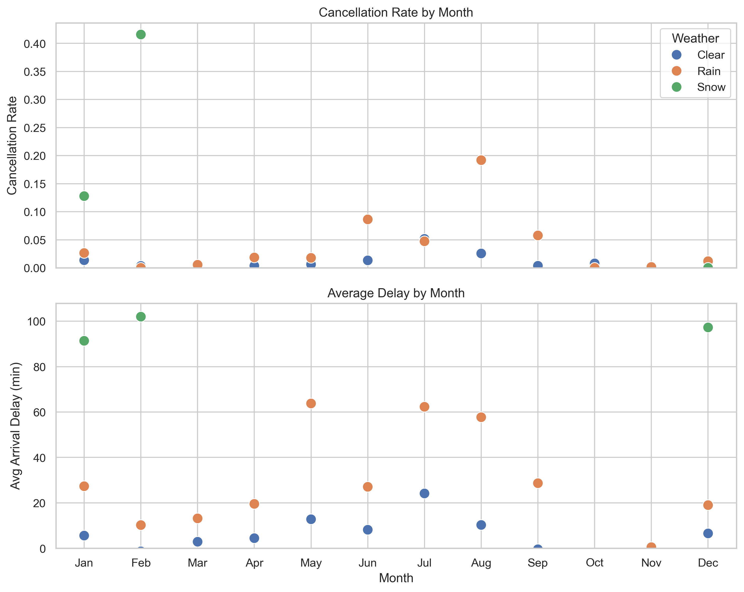
Flights delays by month – weather impact
Weather-related delays vary seasonally.
Snow causes the most severe disruptions.
Rain worsens delays during busy months.
Many delays occur even in clear conditions.

Slide 15
Conclusion
Airline Performance
Delta Air Lines demonstrates the strongest overall reliability consistently lower delay and cancellation rates.
Southwest and United also show strong operational stability across the network.
Frontier Airlines show the highest disruption, driven by frequent delays and elevated cancellations.
Best Travel Times
Worst: Peak travel seasons — Summer and Winter
Best: Shoulder months with lower demand and fewer disruptions
Time of Day
Worst: Evening and Night, when delays accumulate across the network
Best: Morning, when schedules have greater recovery capacity
What Drives Delays
Operational factors are the primary drivers of delays throughout the year.
Weather impacts are secondary and seasonal, intensifying disruption during specific periods rather than driving daily delays.

